Slide 1
Banking Management System in Python
Submitted By:
Himanshu Rajput
Technology Used:
Python
Dictionary
Functions

Slide 2
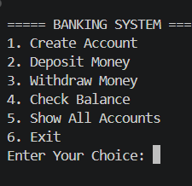
Introduction & Objectives
Introduction
Banking Management System is a console-based Python application.
It performs basic banking operations.
Objectives
Create bank accounts
Deposit money
Withdraw money
Check balance
Display account details

Slide 3
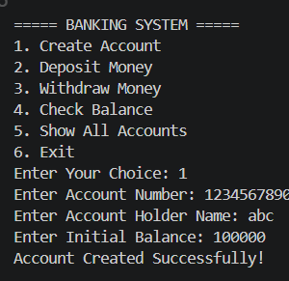
Working of the Project
Workflow
Start Program ↓ Display Menu ↓ User Selects Option ↓ Perform Operation ↓ Return to Menu ↓ Exit

Slide 4
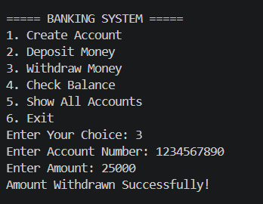
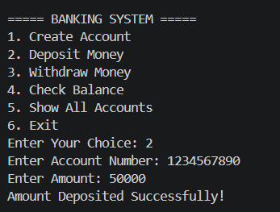
Logic Used
Python Concepts Used
Dictionary for storing accounts
Functions for operations
Loops for menu repetition
Conditional Statements for validation
Dictionary Example
accounts = {
"101": {
"name": "Himanshu",
"balance": 5000
}
}

Slide 5
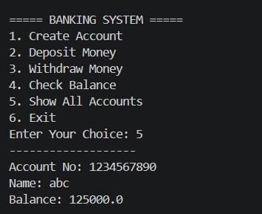
Features & Conclusion
Features
Create Account
Deposit Money
Withdraw Money
Check Balance
Show All Accounts
Input Validation
Conclusion
Learned Python functions, dictionaries, loops, and real-world problem solving.

